Slide 1
Familiarize yourself with phishing attacks
HR and Marketing Teams

Slide 2
What is phishing?
Phishing is a cyber attack tactic
It involves deception to trick individuals
Attackers use fake emails, websites, or messages
Attacks aim to get sensitive information (passwords, SSN, credit card numbers etc.)
Emails and messages often appear from trusted sources
Can lead to ID theft, financial loss, unauthorized access
Exploits human psychology thru
Urgency, fear, trust, authority, familiarity, social proof, scarcity

Slide 3
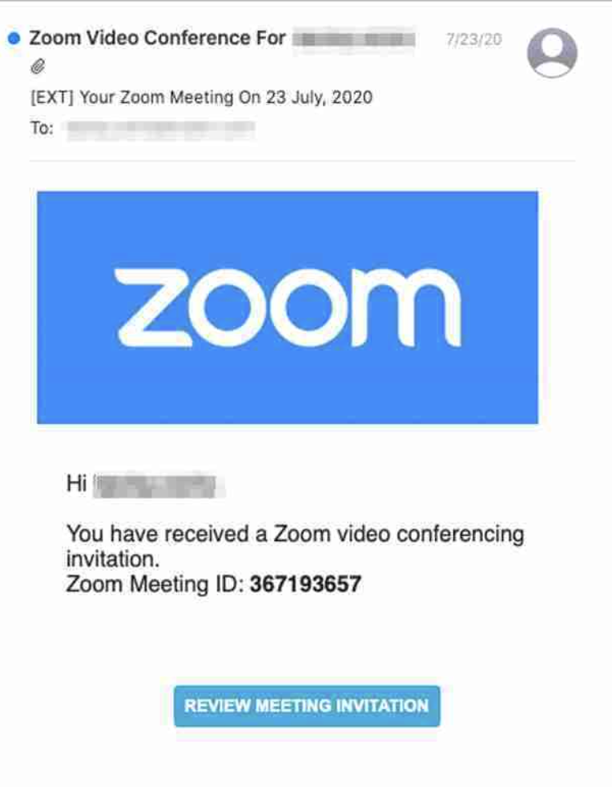
Learn to spot phishing emails
Out of the 4 emails shown which is real?

Slide 4
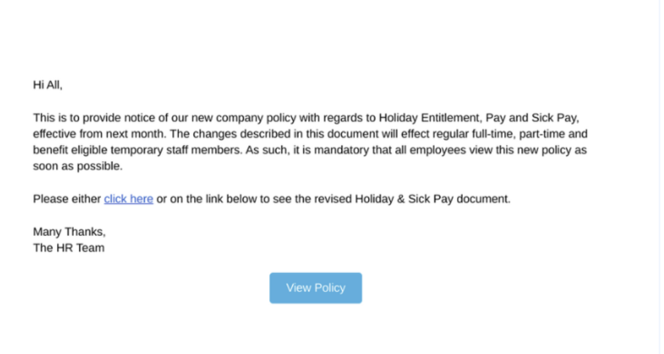
Learn to spot phishing emails
Out of the 4 emails shown which is real?

Slide 5
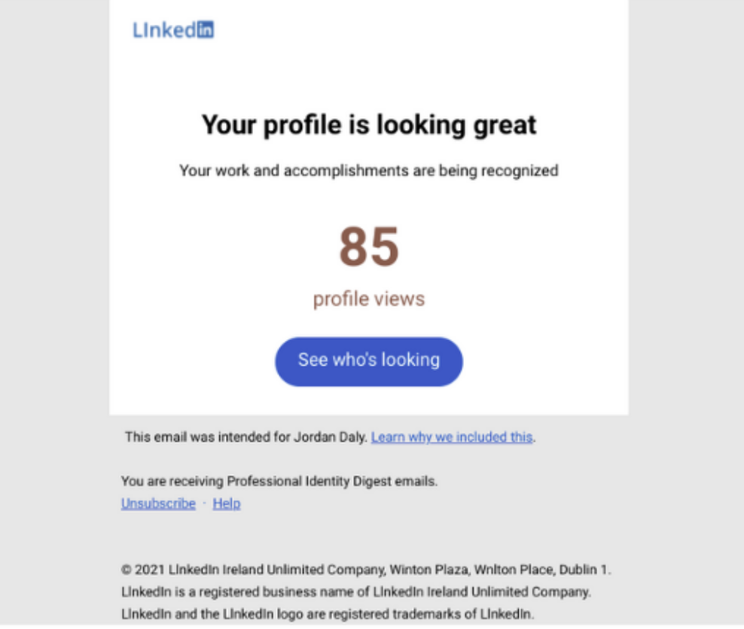
Learn to spot phishing emails
Out of the 4 emails shown which is real?

Slide 6
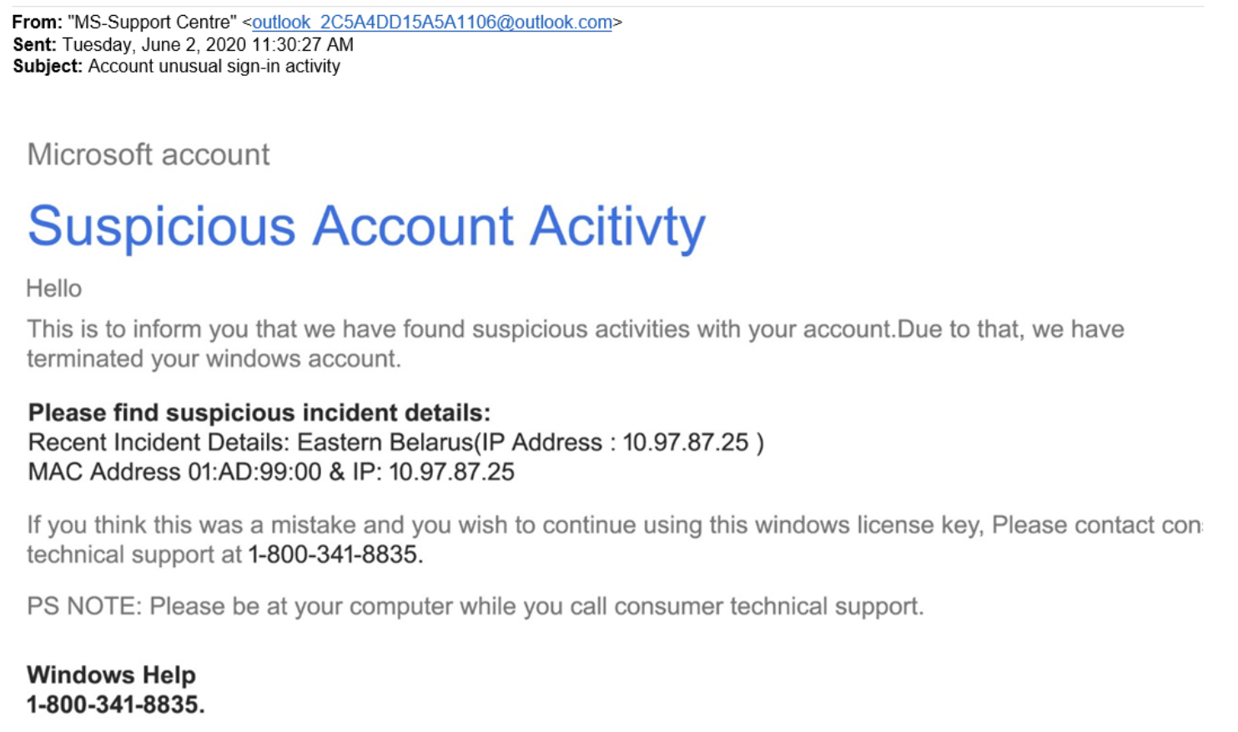
Learn to spot phishing emails
Out of the 4 emails shown which is real?

Slide 7
Learn to spot phishing emails
….They are all phishing emails

Slide 8
How do we stop getting phished?
Verify Sender Information
Look for misspellings
Be skeptical of emails requesting sensitive information
Look for grammar and misspellings
Don't trust unsolicited attachments
Use MFA (multi-factor authentication)
Report suspicious emails
Keep antivirus software up to date
Use spam filters
Hover links before clicking or don't click at all
Hover cursor over link to preview URL (in most situations)
Manually type in web address if needed

